Slide 1
Chapter 1
Data Preprocessing

Slide 2
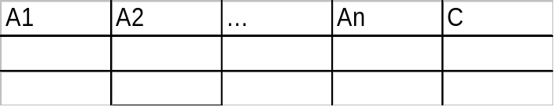
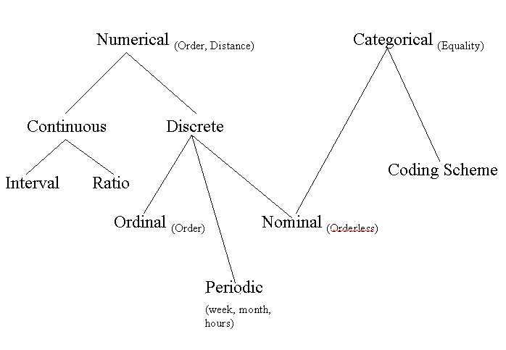
Data Types and Forms
Attribute-value data:
Data types
  numeric, categorical (see the hierarchy for its relationship)
  static, dynamic (temporal)
Other kinds of data
  distributed data
  text, Web, meta data
  images, audio/video

Slide 3
Chapter 2: Data Preprocessing
Why preprocess the data?
Data cleaning
Data integration and transformation
Data reduction
Discretization
Summary

Slide 4
Why Data Preprocessing?
Data in the real world is dirty
  incomplete: missing attribute values, lack of certain attributes of interest, or containing only aggregate data
    e.g., occupation=“”
  noisy: containing errors or outliers
    e.g., Salary=“-10”
  inconsistent: containing discrepancies in codes or names
    e.g., Age=“42” Birthday=“03/07/1997”
    e.g., Was rating “1,2,3”, now rating “A, B, C”
    e.g., discrepancy between duplicate records

Slide 5
Why Is Data Preprocessing Important?
No quality data, no quality mining results!
  Quality decisions must be based on quality data
    e.g., duplicate or missing data may cause incorrect or even misleading statistics.
Data preparation, cleaning, and transformation comprises the majority of the work in a data mining application (90%).

Slide 6
Multi-Dimensional Measure of Data Quality
A well-accepted multi-dimensional view:
  Accuracy
  Completeness
  Consistency
  Timeliness
  Believability
  Value added
  Interpretability
  Accessibility

Slide 7
Major Tasks in Data Preprocessing
Data cleaning
  Fill in missing values, smooth noisy data, identify or remove outliers and noisy data, and resolve inconsistencies
Data integration
  Integration of multiple databases, or files
Data transformation
  Normalization and aggregation
Data reduction
  Obtains reduced representation in volume but produces the same or similar analytical results
Data discretization (for numerical data)

Slide 8
Chapter 2: Data Preprocessing
Why preprocess the data?
Data cleaning
Data integration and transformation
Data reduction
Discretization
Summary

Slide 9
Data Cleaning
Importance
  “Data cleaning is the number one problem in data warehousing”
Data cleaning tasks
  Fill in missing values
  Identify outliers and smooth out noisy data
  Correct inconsistent data
  Resolve redundancy caused by data integration

Slide 10
Missing Data
Data is not always available
  E.g., many tuples have no recorded values for several attributes, such as customer income in sales data
Missing data may be due to
  equipment malfunction
  inconsistent with other recorded data and thus deleted
  data not entered due to misunderstanding
  certain data may not be considered important at the time of entry
  not register history or changes of the data

Slide 11
How to Handle Missing Data?
Ignore the tuple
Fill in missing values manually: tedious + infeasible?
Fill in it automatically with
  a global constant : e.g., “unknown”, a new class?!
  the attribute mean
  the most probable value: inference-based such as Bayesian formula, decision tree, or EM algorithm

Slide 12
Noisy Data
Noise: random error or variance in a measured variable.
Incorrect attribute values may due to
  faulty data collection instruments
  data entry problems
  data transmission problems
  etc
Other data problems which requires data cleaning
  duplicate records, incomplete data, inconsistent data

Slide 13
How to Handle Noisy Data?
Binning method:
  first sort data and partition into (equi-depth) bins
  then one can smooth by bin means, smooth by bin median, smooth by bin boundaries, etc.
Clustering
  detect and remove outliers
Combined computer and human inspection
  detect suspicious values and check by human (e.g., deal with possible outliers)

Slide 14
Binning Methods for Data Smoothing
Sorted data for price (in dollars): 4, 8, 9, 15, 21, 21, 24, 25, 26, 28, 29, 34
Partition into (equi-depth) bins:
  Bin 1: 4, 8, 9, 15
  Bin 2: 21, 21, 24, 25
  Bin 3: 26, 28, 29, 34
Smoothing by bin means:
  Bin 1: 9, 9, 9, 9
  Bin 2: 23, 23, 23, 23
  Bin 3: 29, 29, 29, 29
Smoothing by bin boundaries:
  Bin 1: 4, 4, 4, 15
  Bin 2: 21, 21, 25, 25
  Bin 3: 26, 26, 26, 34

Slide 15
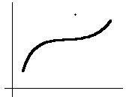
Outlier Removal
Data points inconsistent with the majority of data
Different outliers
  Valid: CEO’s salary,
  Noisy: One’s age = 200, widely deviated points
Removal methods
  Clustering
  Curve-fitting
  Hypothesis-testing with a given model

Slide 16
Chapter 2: Data Preprocessing
Why preprocess the data?
Data cleaning
Data integration and transformation
Data reduction
Discretization
Summary

Slide 17
Data Integration
Data integration:
  combines data from multiple sources
Schema integration
  integrate metadata from different sources
  Entity identification problem: identify real world entities from multiple data sources, e.g., A.cust-id ≡ B.cust-#
Detecting and resolving data value conflicts
  for the same real world entity, attribute values from different sources are different, e.g., different scales, metric vs. British units
Removing duplicates and redundant data

Slide 18
Data Transformation
Smoothing: remove noise from data
Normalization: scaled to fall within a small, specified range
Attribute/feature construction
  New attributes constructed from the given ones
Aggregation: summarization
Generalization: concept hierarchy climbing

Slide 19




Data Transformation: Normalization
min-max normalization
z-score normalization
normalization by decimal scaling
Where j is the smallest integer such that Max(| |)<1

Slide 20
Chapter 2: Data Preprocessing
Why preprocess the data?
Data cleaning
Data integration and transformation
Data reduction
Discretization
Summary

Slide 21
Data Reduction Strategies
Data is too big to work with
Data reduction
  Obtain a reduced representation of the data set that is much smaller in volume but yet produce the same (or almost the same) analytical results
Data reduction strategies
  Dimensionality reduction — remove unimportant attributes
  Aggregation and clustering
  Sampling

Slide 22
Dimensionality Reduction
Feature selection (i.e., attribute subset selection):
  Select a minimum set of attributes (features) that is sufficient for the data mining task.
Heuristic methods (due to exponential # of choices):
  step-wise forward selection
  step-wise backward elimination
  combining forward selection and backward elimination
  etc

Slide 23
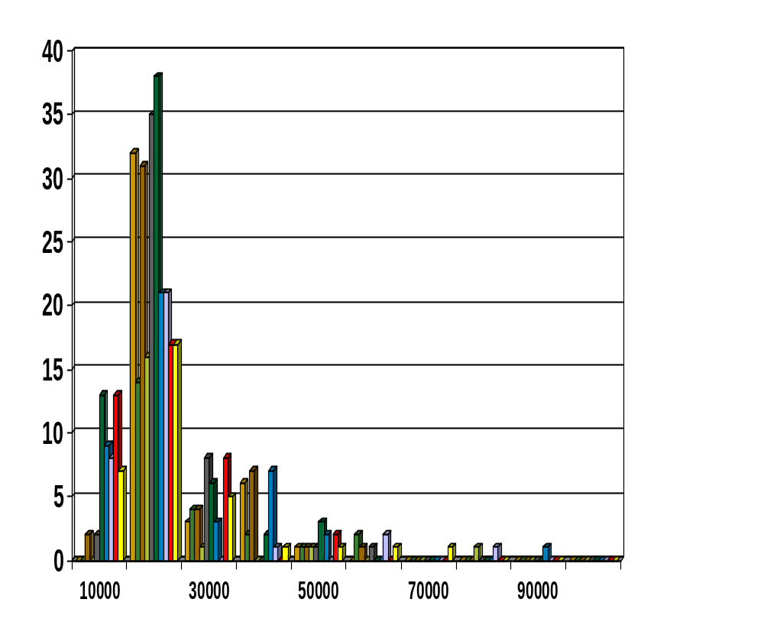
Histograms
A popular data reduction technique
Divide data into buckets and store average (sum) for each bucket

Slide 24
Clustering
Partition data set into clusters, and one can store cluster representation only
Can be very effective if data is clustered but not if data is “smeared”
There are many choices of clustering definitions and clustering algorithms. We will discuss them later.

Slide 25
Sampling
Choose a representative subset of the data
  Simple random sampling may have poor performance in the presence of skew.
Develop adaptive sampling methods
  Stratified sampling:
    Approximate the percentage of each class (or subpopulation of interest) in the overall database
    Used in conjunction with skewed data

Slide 26
Sampling
Raw Data
Cluster/Stratified Sample

Slide 27
Chapter 2: Data Preprocessing
Why preprocess the data?
Data cleaning
Data integration and transformation
Data reduction
Discretization
Summary

Slide 28
Discretization
Three types of attributes:
  Nominal — values from an unordered set
  Ordinal — values from an ordered set
  Continuous — real numbers
Discretization:
  divide the range of a continuous attribute into intervals because some data mining algorithms only accept categorical attributes.
Some techniques:
  Binning methods – equal-width, equal-frequency
  Entropy-based methods

Slide 29
Discretization and Concept Hierarchy
Discretization
  reduce the number of values for a given continuous attribute by dividing the range of the attribute into intervals. Interval labels can then be used to replace actual data values
Concept hierarchies
  reduce the data by collecting and replacing low level concepts (such as numeric values for the attribute age) by higher level concepts (such as young, middle-aged, or senior)

Slide 30
Binning
Attribute values (for one attribute e.g., age):
  0, 4, 12, 16, 16, 18, 24, 26, 28
Equi-width binning – for bin width of e.g., 10:
  Bin 1: 0, 4 [-,10) bin
  Bin 2: 12, 16, 16, 18 [10,20) bin
  Bin 3: 24, 26, 28 [20,+) bin
  – denote negative infinity, + positive infinity
Equi-frequency binning – for bin density of e.g., 3:
  Bin 1: 0, 4, 12 [-, 14) bin
  Bin 2: 16, 16, 18 [14, 21) bin
  Bin 3: 24, 26, 28 [21,+] bin

Slide 31
Entropy-based (1)
Given attribute-value/class pairs:
  (0,P), (4,P), (12,P), (16,N), (16,N), (18,P), (24,N), (26,N), (28,N)
Entropy-based binning via binarization:
  Intuitively, find best split so that the bins are as pure as possible
  Formally characterized by maximal information gain.
Let S denote the above 9 pairs, p=4/9 be fraction of P pairs, and n=5/9 be fraction of N pairs.
Entropy(S) = - p log p - n log n.
  Smaller entropy – set is relatively pure; smallest is 0.
  Large entropy – set is mixed. Largest is 1.

Slide 32
Entropy-based (2)
Let v be a possible split. Then S is divided into two sets:
  S1: value <= v and S2: value > v
Information of the split:
  I(S1,S2) = (|S1|/|S|) Entropy(S1)+ (|S2|/|S|) Entropy(S2)
Information gain of the split:
  Gain(v,S) = Entropy(S) – I(S1,S2)
Goal: split with maximal information gain.
Possible splits: mid points b/w any two consecutive values.
For v=14, I(S1,S2) = 0 + 6/9*Entropy(S2) = 6/9 * 0.65 = 0.433
  Gain(14,S) = Entropy(S) - 0.433
  maximum Gain means minimum I.
The best split is found after examining all possible splits.

Slide 33
Summary
Data preparation is a big issue for data mining
Data preparation includes
  Data cleaning and data integration
  Data reduction and feature selection
  Discretization
Many methods have been proposed but still an active area of research

